Slide 1
Social Chatbot Strategies for Sentiment Judgement
Final Project Presentation
Xingxin Ma

Slide 2
Contents
Project Introduction
Prior work in the area
Project flow chart
Data set and preprocessing
Model fine-tuning
Build a chatbot
Test
Summary

Slide 3
Project Introduction
Problems statement: Many existing chatbots do not effectively support sentiment judgement, do not differentiate between response strategies for different emotions.
Project objectives:
Try to use GPT2 fine-tuning to get a text sentiment analysis model which can estimate if sentence is positive or negative.
Make a chatbot with sentiment judgement using fine-tuned model.

Slide 4
Prior work in the area
Paper: Improving Language Understanding by Generative Pre-Training: Giving a way that pre-training of a language model on a diverse corpus of unlabeled text, and followed by discriminative fine-tuning on each specific task.
Paper: Attention Is All You Need: proposed a new simple network architecture, the Transformer.
Paper: Effective Social Chatbot Strategies for Increasing User Initiative: Giving some strategies to improve user initiative.
Paper: Marketing Research: The Role Of Sentiment Analysis: This article promotes sentiment analysis as an alternative research technique for collecting and analyzing textual data on the internet.

Slide 5
Project flow chart
Data preprocess
Fine-tuning on google colab
Local chat bot
Test
Local
Python
Cloud
Python
Pytorch
Transformer
Got model
Local
Python
Pycharm
Use model
Local
Python
Chatbot test
Model test

Slide 6
Data set(Supervised training)
Amazon Reviews for Sentiment Analysis
https://www.kaggle.com/datasets/bittlingmayer/amazonreviews?select=train.ft.txt.bz2
This dataset consists of a few million Amazon customer reviews (input text) and star ratings (output labels).
The training data size is 1.6G. It contains 3.6M text reviews and ratings for training.
In the data, the classes are __label__1 and __label__2, and there is only one class per row.
__label__1 corresponds to 1- and 2-star reviews, and __label__2 corresponds to 4- and 5-star reviews.
(3-star reviews i.e. reviews with neutral sentiment were not included in the original),

Slide 7
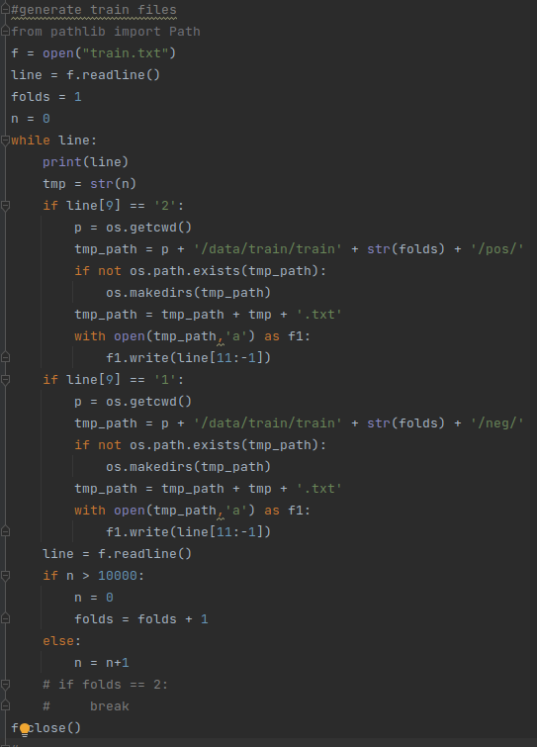
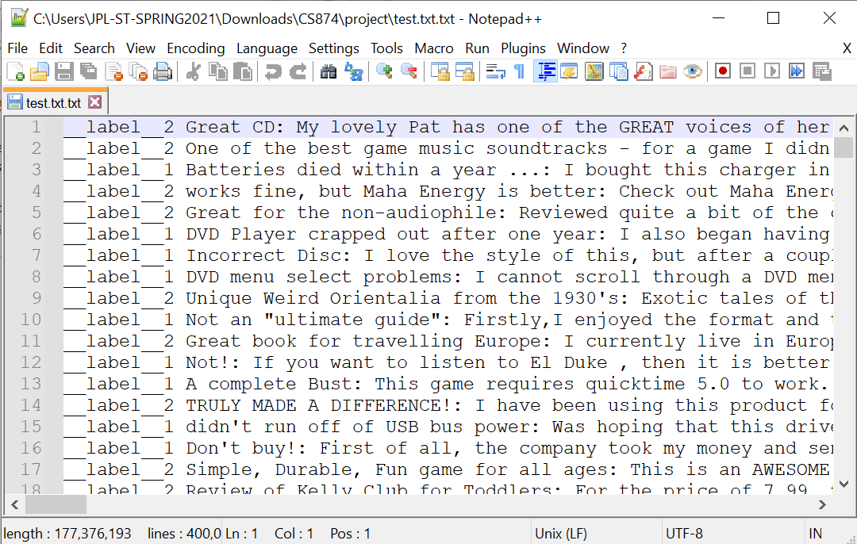
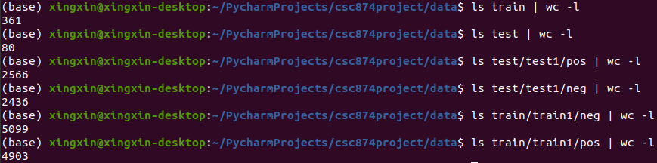
Data preprocessing: step 1
Before data preprocessing:
Divide data into pos and neg folder, each file contents 1 line of the original data:
After step 1:

Slide 8
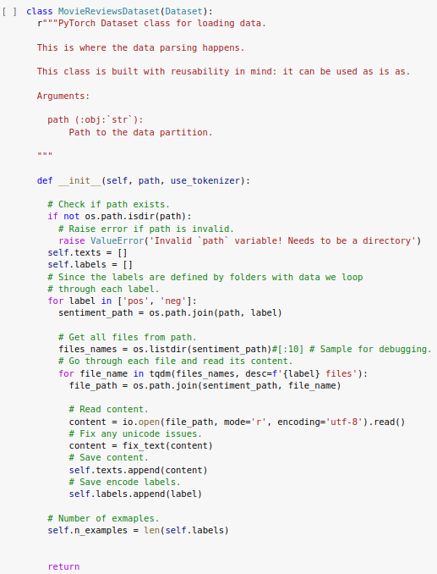
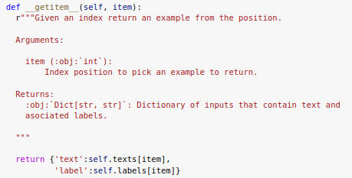
Data preprocessing: step 2
Transfer txt data into two lists: label and data, combine them to dictionary data.
Load the dictionary data to pytorch dataloader using gpt2 collator.
After step 2: I got the loaded data which can be used to train.

Slide 9
Model fine-tuning
Transformerr
GPT2 Collator
GPT2 Tokenizer
GPT2 pretrained model
Preprocessed data
Pytorch train
Fine-tuned model(.pth)
Thanks for Transformer library, it did a lot of work for GPT2!

Slide 10
Chatbot
Process flow diagram
Select a special usage scenario to simplify the chatbot building.
Usage scenario: Ella is a chatbot in the shopping mall. Her job is to guide the customer and collecting complaints if any.
Made ShopAssistant python class.
Text input in console
If for guide
N
Y
If end
N
Y
Text output in console
If negative
Y
N

Slide 11
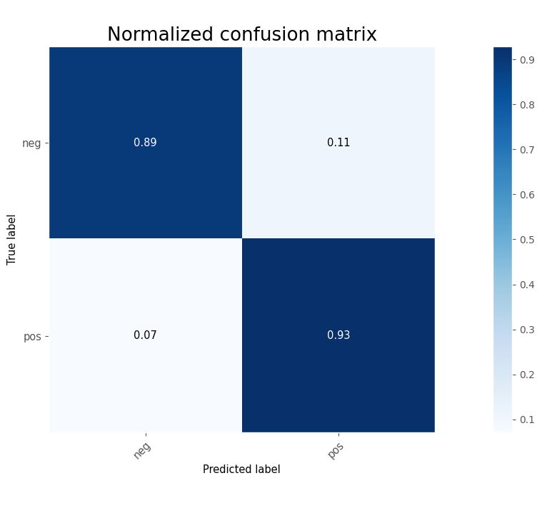
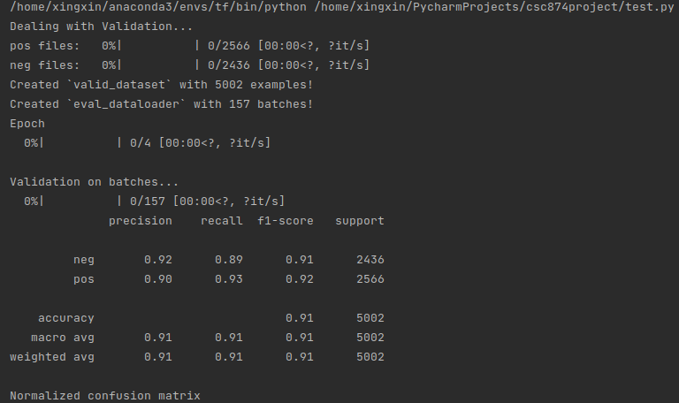
Test 1. model
I used about 5000 testing data set to test(different from the training set).

Slide 12
Explanation to the result:
Precision:
True positive/(True positive + False positive)
Recall:
True positive/(True positive + False negative)
Support:
This row’s sample number
f1-score:
F1 = 2*Precision*Recall/(Precision + Recall)
micro avg：Calculate correct prediction including all the data. For example in 5 samples, 3 predict correctly, so micro avg is 3/5.
macro avg：Weight added micro avg
From the test result, the precision of the model is good.

Slide 13
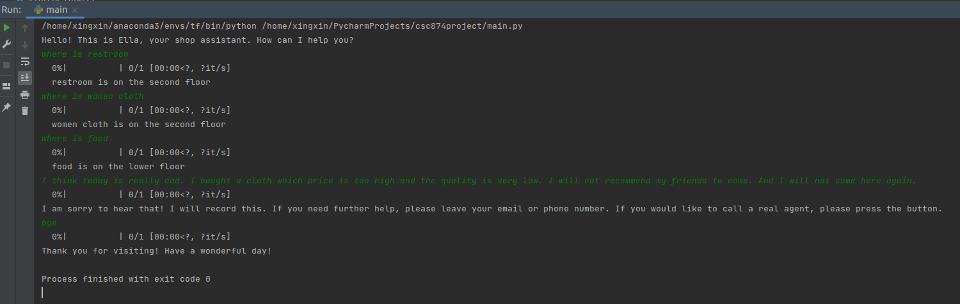
Test 2 Ella
I tested Ella’s logic and the judgement branch to deal with a complaint.

Slide 14
Summary
In this project I build a simple chatbot Ella for “shopping mall assistant” usage scenario.
In Ella I add complaints dealing logic using gpt2 sentimental analysis fine-tuned model.
I tested the model and the precise is good(around 90%).
The python files I used:
Main.py: agent
Test.py: model testing
dataPreprocess.py: data preprocess
Finetuning.py: fine tuning model
ShopAssistant.py: Ella

Slide 15
Thanks to transformer team! Thanks to George Mihaila! I referred his tutorial code in this project, the original code link is as below:
https://colab.research.google.com/github/gmihaila/ml_things/blob/master/notebooks/pytorch/gpt2_finetune_classification.ipynb

Slide 16
Thanks for listening!

